Slide 1
VARUN KARTHIK
Final Project
3/21/2024 Annual Review

Slide 2
PROJECT TITLE
GESTURE RECOGNITION USING CNN

Slide 3
AGENDA
Introduction: Explain gesture recognition using CNNs.
Background Research: Review existing literature.
Data Collection: Gather diverse gesture datasets.
Data Preprocessing: Enhance image quality and augment dataset.
Model Architecture Design: Design CNN architecture.
Model Training: Train CNN model, tune hyperparameters.
Evaluation: Assess model performance using metrics.
Fine-Tuning: Refine model based on evaluation results.
Deployment: Implement in real-world application.
Conclusion: Summarize findings and discuss future directions.

Slide 4

PROBLEM STATEMENT
The problem entails crafting a real-time gesture recognition system leveraging Convolutional Neural Networks (CNNs) to accurately identify and classify hand gestures from webcam feeds. The system aims to recognize a predefined set of gestures encompassing common hand movements and signs, facilitating intuitive human-computer interaction. Challenges include accommodating variations in hand shapes, orientations, and backgrounds, as well as diverse lighting conditions and potential occlusions. The system must discern subtle nuances in hand movements to ensure precise classification. Objectives include designing and training a robust CNN model, implementing real-time processing of webcam feeds, developing efficient classification algorithms, and ensuring the system's accuracy and robustness across different environmental condition.

Slide 5

PROJECT OVERVIEW
The project aims to develop a real-time gesture recognition system using Convolutional Neural Networks (CNNs). Leveraging webcam feeds, the system will accurately classify hand gestures, enabling intuitive human-computer interaction. Challenges include accommodating variations in hand shapes, orientations, and backgrounds, as well as diverse lighting conditions. Objectives encompass designing and training a robust CNN model, implementing real-time processing of webcam feeds, and ensuring system accuracy and robustness across different environments. Successful implementation will enable seamless interaction between users and technology, fostering applications like sign language translation, interactive gaming, and gesture-based interfaces for smart devices, thus enhancing accessibility and user experience..

Slide 6
OBJECTIVE:
Emergency Response Agencies: Timely alerts empower these organizations to strategically allocate resources, enhancing their ability to conduct efficient rescue and relief operations.
Government Entities: Enhanced prediction capabilities offer valuable insights for policymakers, guiding decisions regarding infrastructure development and the formulation of robust disaster preparedness strategies.
Residents in High-Risk Zones: Early warnings equip individuals living in earthquake-prone areas with crucial lead time to evacuate safely and implement personal safety measures.
Businesses and Industries: Improved prediction models enable businesses to enact continuity plans, minimizing operational disruptions and safeguarding assets in the event of earthquakes.
Scientific Community: Advancements in earthquake prediction not only contribute to scientific knowledge but also facilitate ongoing research efforts aimed at refining prediction techniques and enhancing disaster resilience.

Slide 7
YOUR SOLUTION AND ITS VALUE PROPOSITION
Solution: The proposed solution entails developing a real-time gesture recognition system utilizing Convolutional Neural Networks (CNNs). By training the CNN model on a diverse dataset of hand gestures, the system can accurately classify gestures captured from webcam feeds in real-time. Advanced preprocessing techniques and robust classification algorithms will be employed to handle variations in hand shapes, orientations, backgrounds, and lighting conditions.
Value Proposition: This solution offers a transformative approach to human-computer interaction, enabling intuitive control of devices and applications through natural hand gestures. By seamlessly integrating gesture recognition technology into various domains such as sign language translation, interactive gaming, and smart device interfaces, it enhances accessibility, user experience, and productivity. Moreover, its real-time capabilities empower users with efficient and responsive interactions, unlocking new possibilities for immersive and engaging digital experiences.

Slide 8
The Wow Factor in Your Solution
The proposed solution incorporates a cutting-edge aspect of artificial intelligence—Convolutional Neural Networks (CNNs)—to enable real-time gesture recognition. What makes this solution truly remarkable is its ability to harness the power of deep learning to understand and interpret human gestures accurately and swiftly. By leveraging state-of-the-art CNN architectures, the system not only recognizes a diverse range of hand movements but also adapts to various environmental conditions seamlessly. This groundbreaking technology opens doors to a future where human-computer interaction transcends traditional input methods, offering users a truly intuitive and immersive experience. Its potential to revolutionize accessibility, gaming, virtual reality, and beyond makes it a standout solution in the realm of gesture recognition technology.

Slide 9
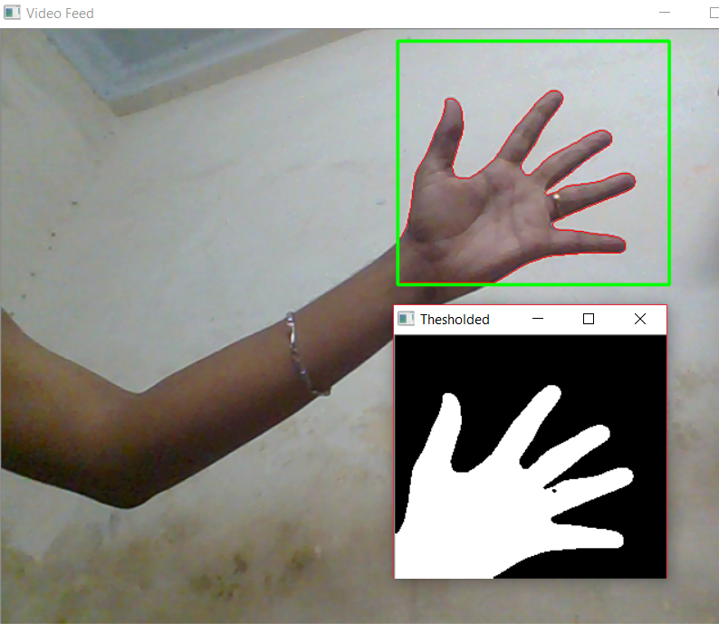
RESULTS
EARTHQUAKE LOCATIONS AND MAGNITUDES

Slide 10
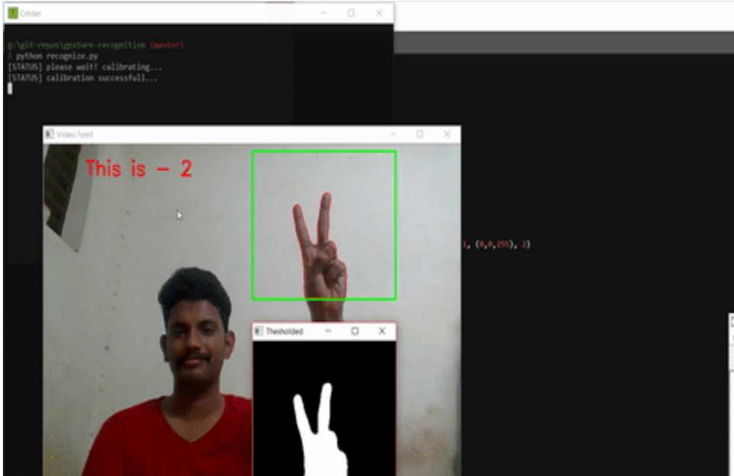
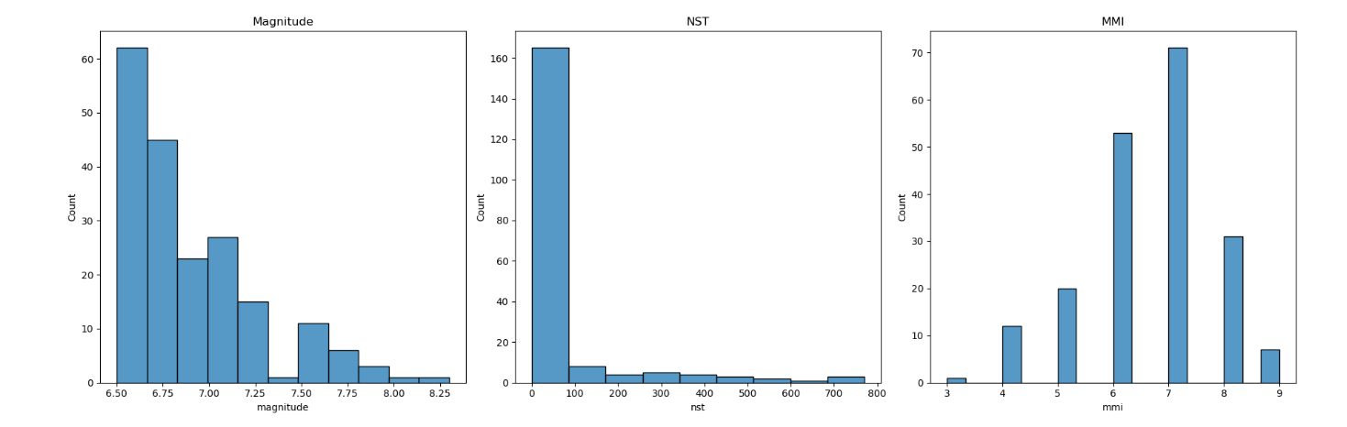
Results
DRIVE LINK:
https://colab.research.google.com/drive/10ueMHDkUUqu6mwReVwJvLS-bUk2c3sRz?usp=drive_link

Slide 11
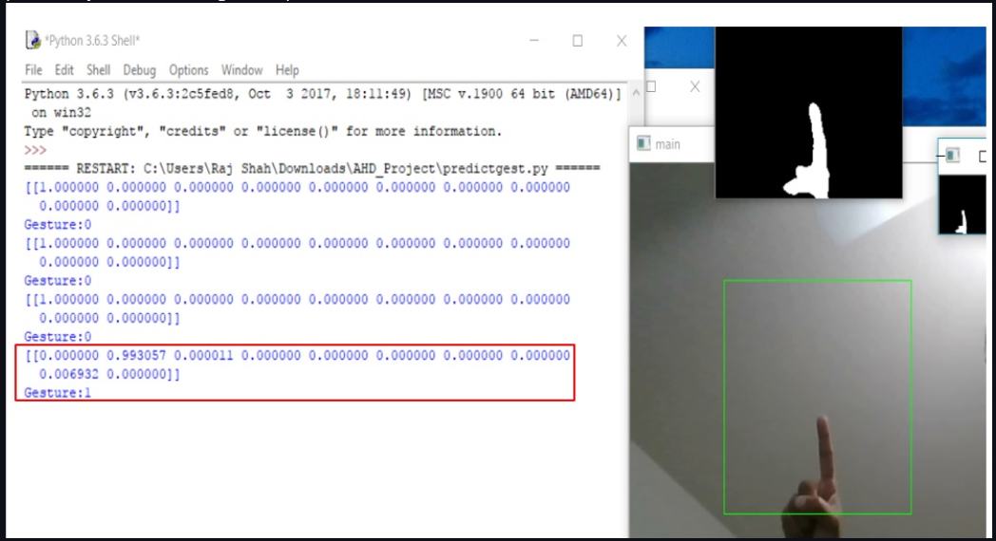
Accuracy of the model

